Slide 1
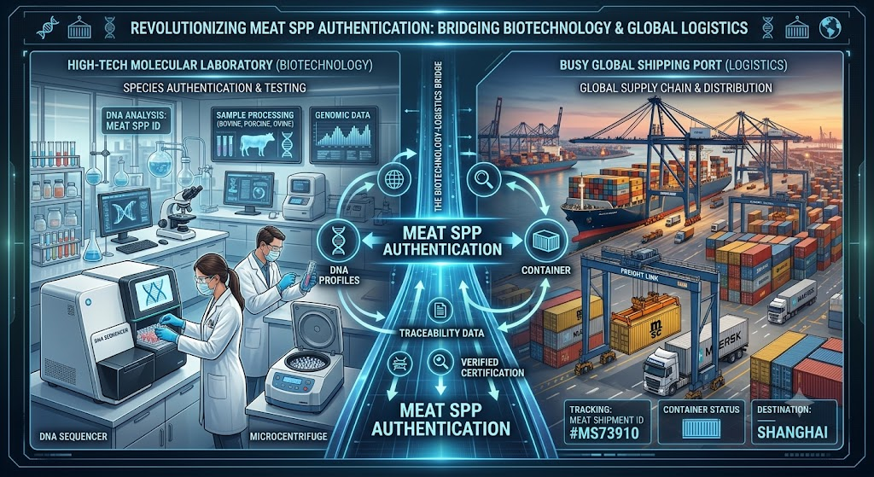
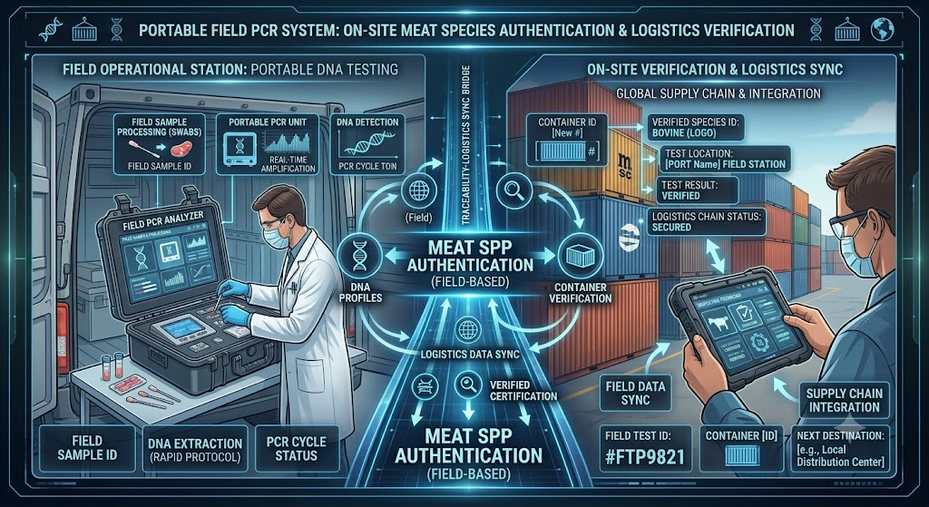
Transitioning DNA analytic devices and technologies to the field
This module consists of theoretical content and case studies. Multiple-choice quizzes are also included to reinforce learning and assess understanding.

Slide 2
Can we take qPCR out of the lab?
  Yes, portable thermocyclers have been available commercially.
  An example is the Biomeme Franklin benchtop PCR weighted 2.65-pound, with battery-powered box. It operates via Bluetooth connected to a smartphone app, processing up to 9 samples simultaneously.
  To avoid aerosol DNA contamination in field environments, testing can be conducted inside sealed, ethanol-decontaminated portable glove boxes. This provides full biosafety and forensic containment on-site.

Slide 3
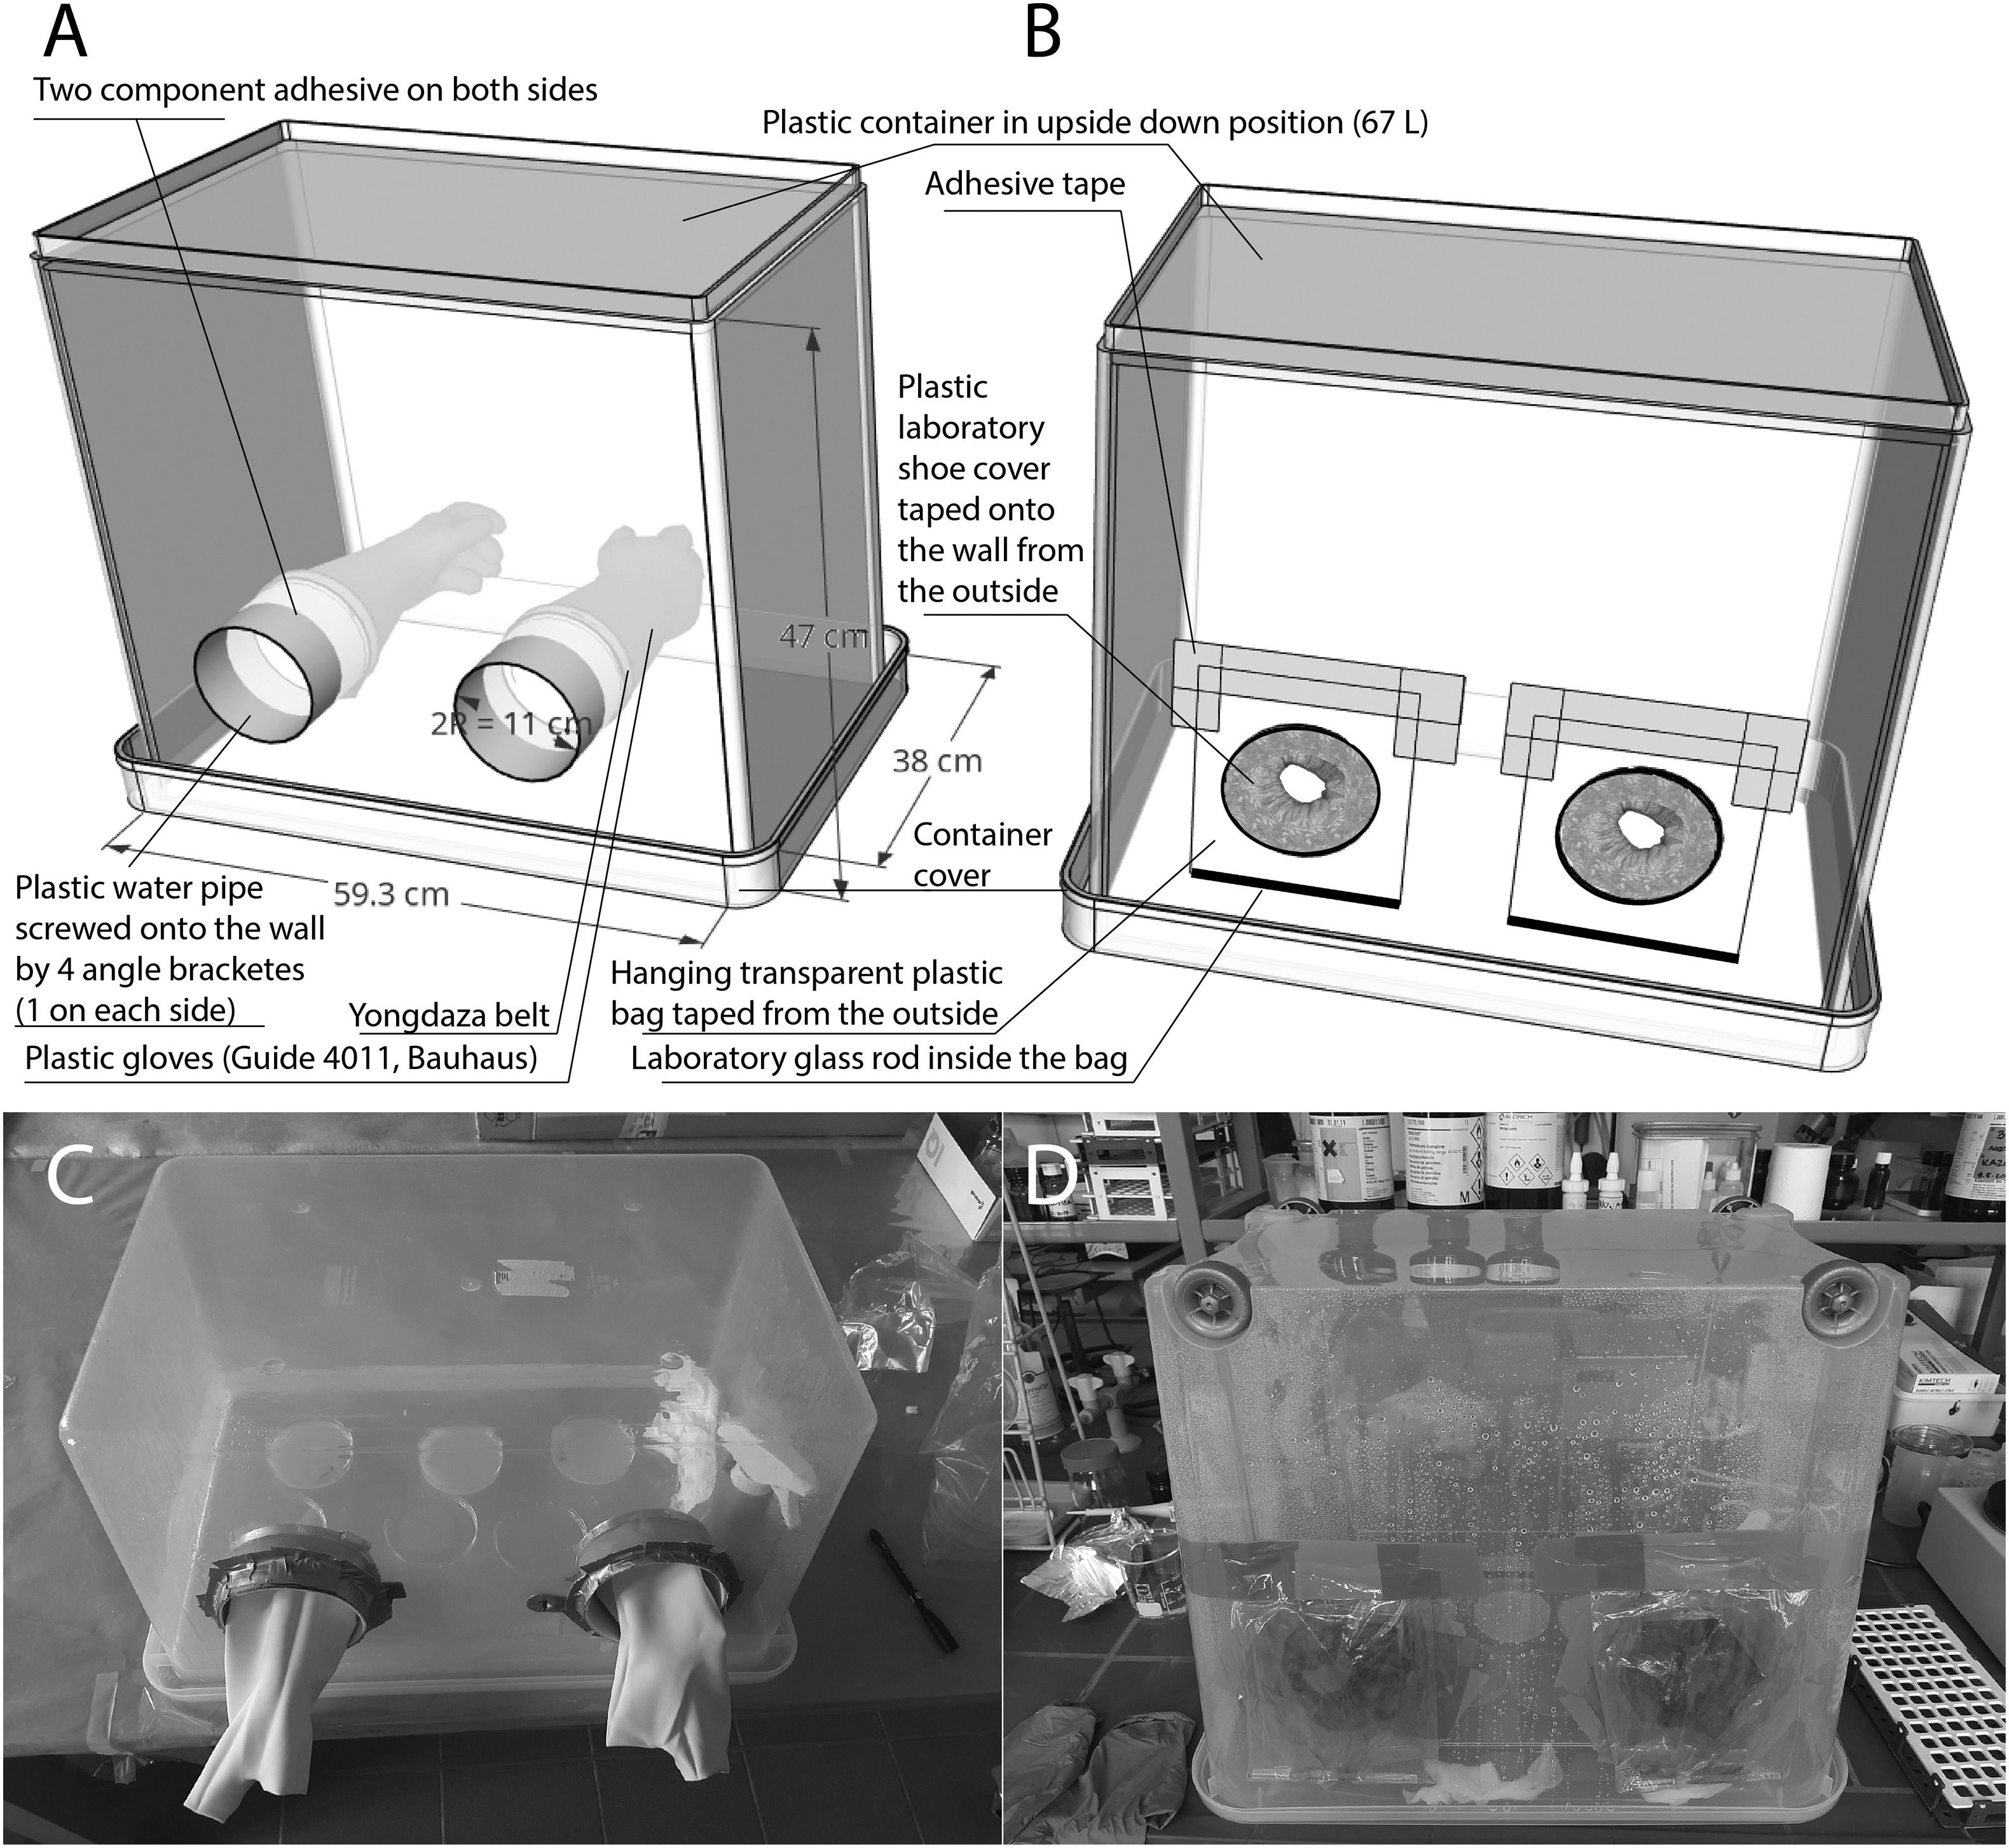
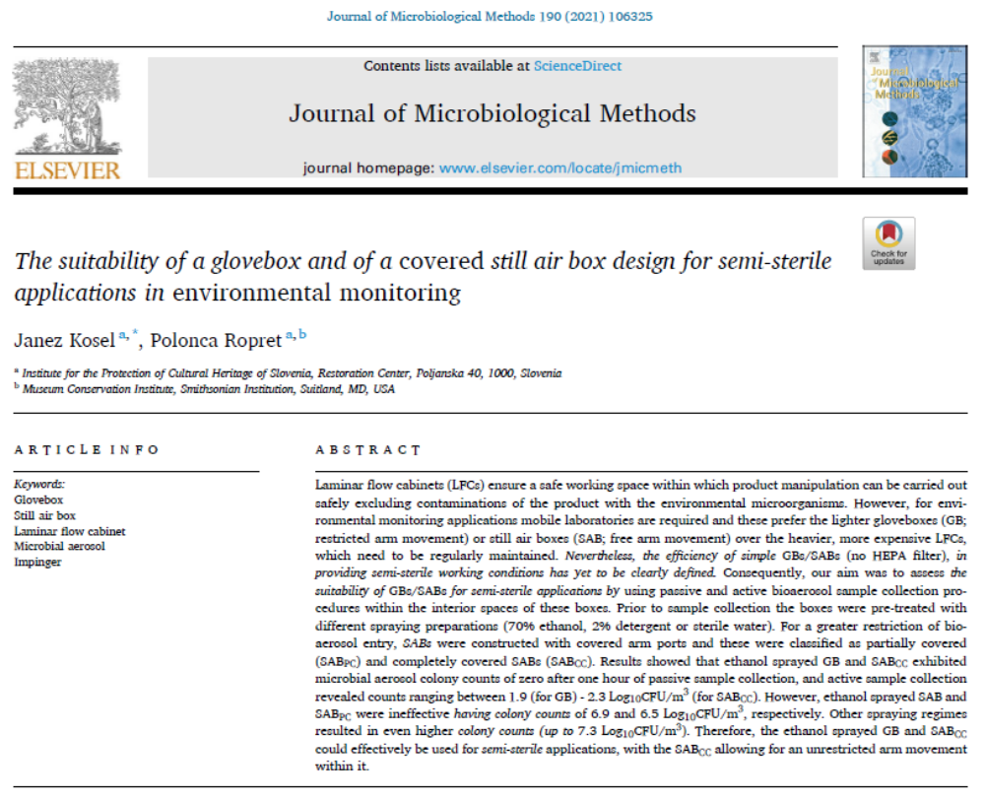
https://doi.org/10.1016/j.mimet.2021.106325

Slide 4
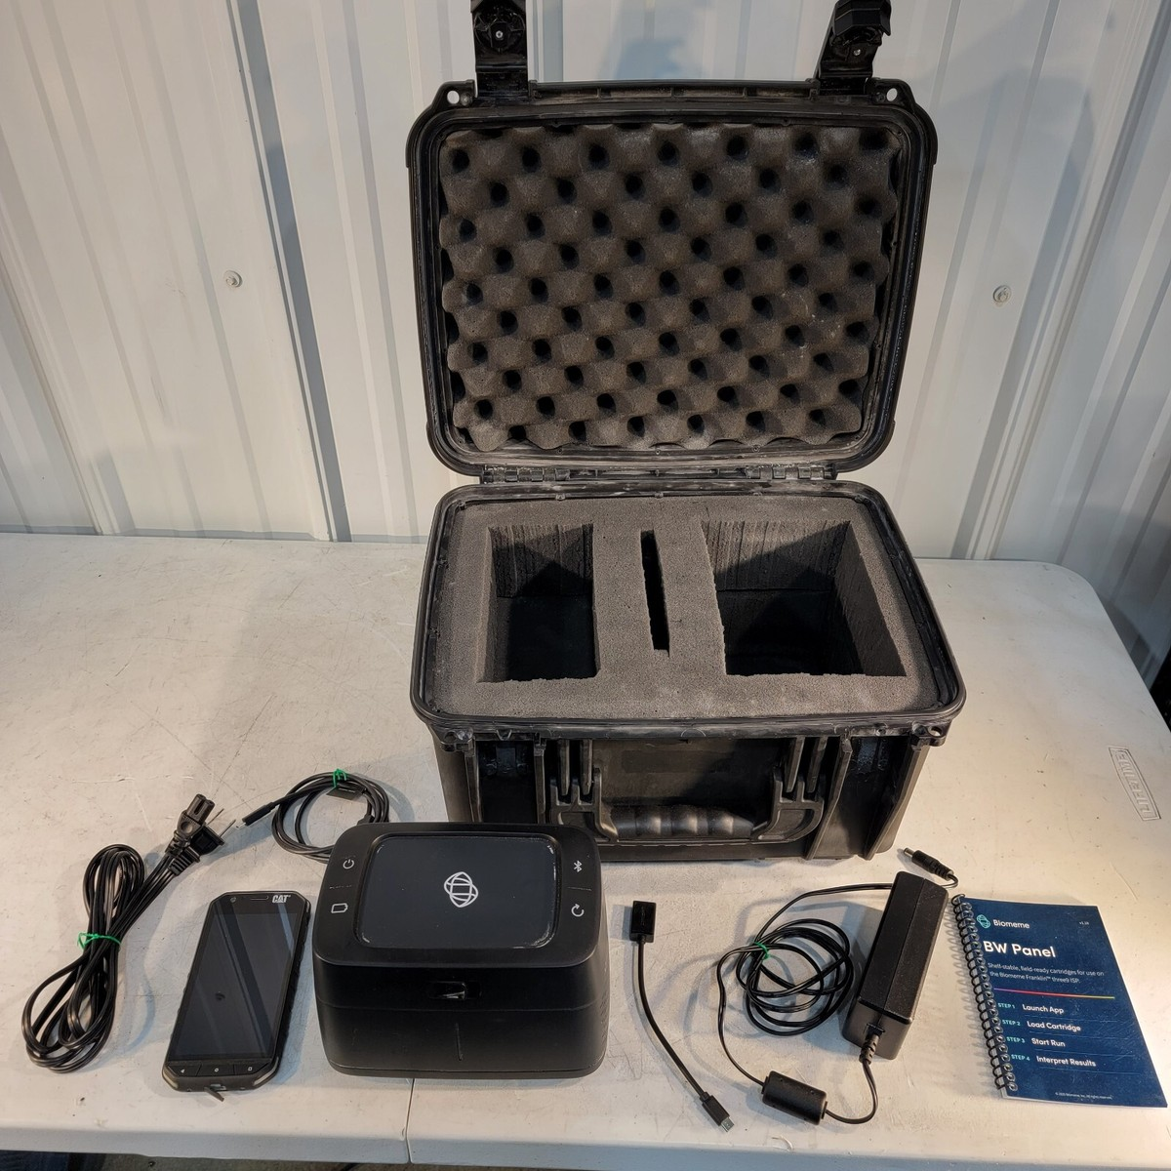
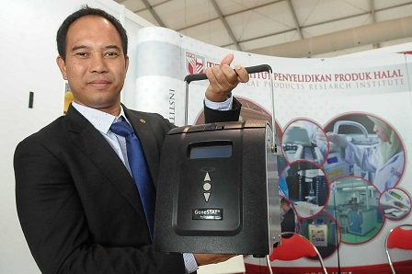
Biomeme Franklin Three9 ISP Rugged Mobile Real-Time PCR Thermocycler in case
HaFYsTM (Halal Verification System) -
A Portable Real-Time PCR System for rapid porcine DNA detection
https://upm.edu.my/kandungan/upm_berjaya_komersialkan_kit_kesan_dna_babi_ke_peringkat_global-25268?L=bm
https://www.ebay.com.my/itm/404661889128

Slide 5
DNA sample for on-site animal species DNA testing using a portable thermocycler
As field-based protocols prioritize speed, portability, and robustness over maximum DNA purity, DNA extraction method is typically simplified to minimize equipment, time, and reagent requirements while still yielding DNA of sufficient quality for PCR amplification.
Portable PCR systems generally amplify short DNA fragments (100–300 bp), making them more tolerant of partially degraded DNA and residual inhibitors.
Therefore:
  High-purity DNA is usually unnecessary.
  Extraction can be completed within 30 minutes
  Minimal laboratory equipment is required.
  The entire workflow (DNA extraction → PCR → result) can often be completed within an hour.

Slide 6
What are the common rapid DNA extraction approaches?
Rapid crude DNA extraction (e.g. heating)
Alkaline lysis
Chelex® extraction
Magnetic bead-based extraction
Paper-based or FTA card extraction

Slide 7
DNA extraction methods for field application are often optimized to:
tolerate environmental contaminants,
require few consumables,
avoid hazardous organic solvents (e.g., phenol-chloroform),
operate without mains electricity
maintain compatibility with portable PCR platforms such as miniPCR, Biomeme Franklin™, or other battery-powered thermocyclers.
rapid heat lysis or Chelex-based extraction are the most commonly adopted methods because they provide sufficient DNA quality for species-specific PCR while keeping the workflow fast, inexpensive, and practical under field conditions.

Slide 8
Data interpretation for field-deployed qPCR
  Field operators would be typically logistic inspectors, not molecular biologists.
  Therefore, if environmental contaminants cause a late-cycle amplification curve around cycle 38, a non-expert might incorrectly classify it as a positive contamination.
  To solve this, a group of researchers developed fuzzy logic algorithms that run in the background of the companion app.
  The model processes the raw inputs from up to four different mitochondrial genes (such as Cytochrome B and 12S/18S rRNA). By mapping the values against validated risk zones, the software automatically provides a direct, risk-assessed "Yes" or "No" result.

Slide 9
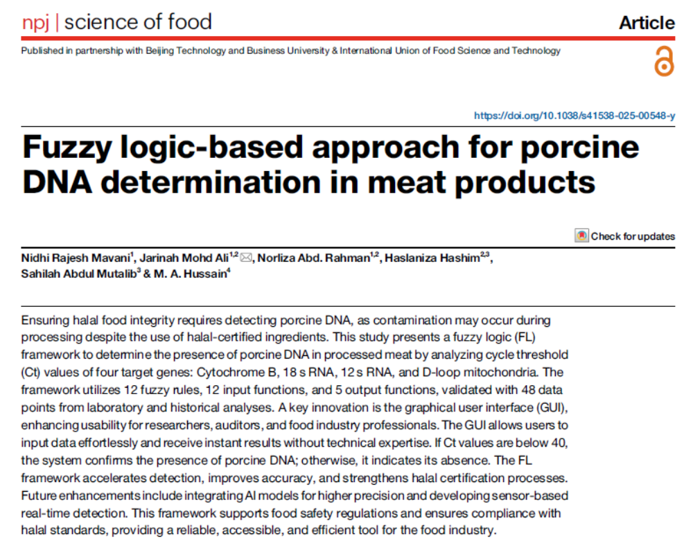
https://doi.org/10.1038/s41538-025-00548-y
Case study - fuzzy logic algorithms

Slide 10
What if we could amplify DNA without any thermal cycling
Recombinase Polymerase Amplification (RPA)
Loop-Mediated Isothermal Amplification (LAMP)
Clustered Regularly Interspaced Short Palindromic Repeats (CRISPR)
Isothermal amplification!
Works at a single temperature

Slide 11
Recombinase Polymerase Amplification (RPA)
  RPA uses recombinase that bind to sequence/target-specific primers (nucleoprotein filament) and scan the double-stranded DNA (sample) to look for homologous sequences.
  Once the target is found and primers are inserted, single-stranded DNA binding proteins stabilize and keep the DNA open.
  Following this stabilization, the recombinase dissociates, exposing the 3' end of the primer.
  A strand-displacing DNA polymerase then extends the primer (copies the template).
  The reaction runs at 37-42°C. Because it runs at body temperature, RPA requires minimal energy, allowing it to be powered by small hand-held batteries or heating blocks.
  Results are generated in just 10 to 20 minutes.

Slide 12
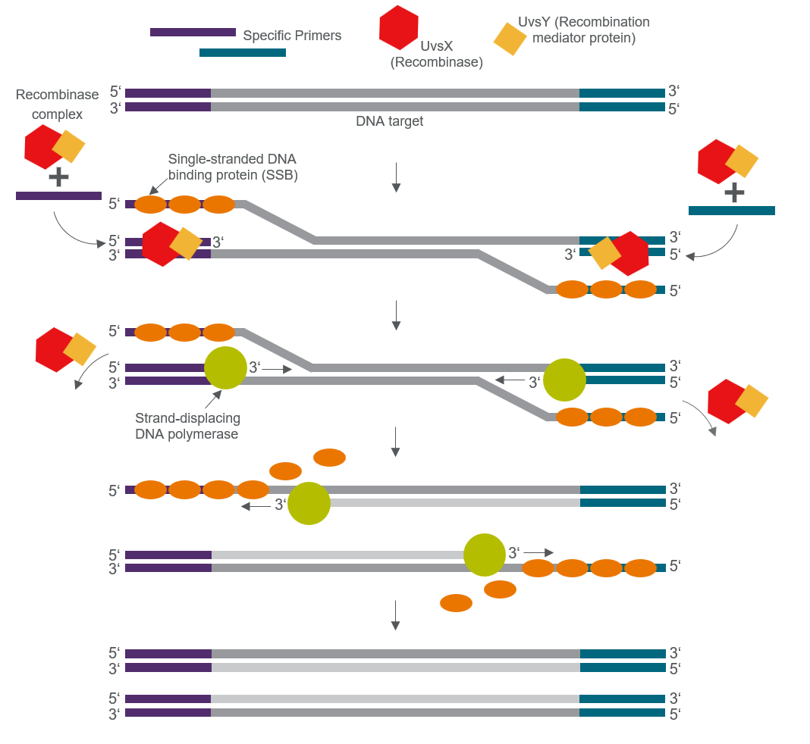
Schematic diagram on the mechanism of RPA
https://www.thermofisher.com/my/en/home/life-science/pcr/isothermal-nucleic-acid-amplification/recombinase-polymerase-amplification.html
Thermo Fisher Scientific Inc.

Slide 13
How do we read the RPA result without lab equipment?
  We couple it with a Nucleic Acid Lateral Flow Immunoassay (NALFIA).
  In this assay, we label the forward primer with FAM and the reverse primer with Biotin.
  If porcine DNA is present, RPA creates amplicons containing FAM (6-carboxyfluorescein - a common hapten label attached to primers or probes, allowing the FAM-tagged amplicon to be captured or detected by anti-FAM antibodies on the strip) at one end and Biotin at the other.
  When loaded onto a lateral flow cassette, the amplicons flow across a paper strip. They bind to anti-biotin carbon particles, migrate, and are captured by anti-FAM antibodies forming a visible dark line, indicating a positive result.
  This method requires no computer, and can achieve a limit of detection as low as 0.01 ng/µL.

Slide 14
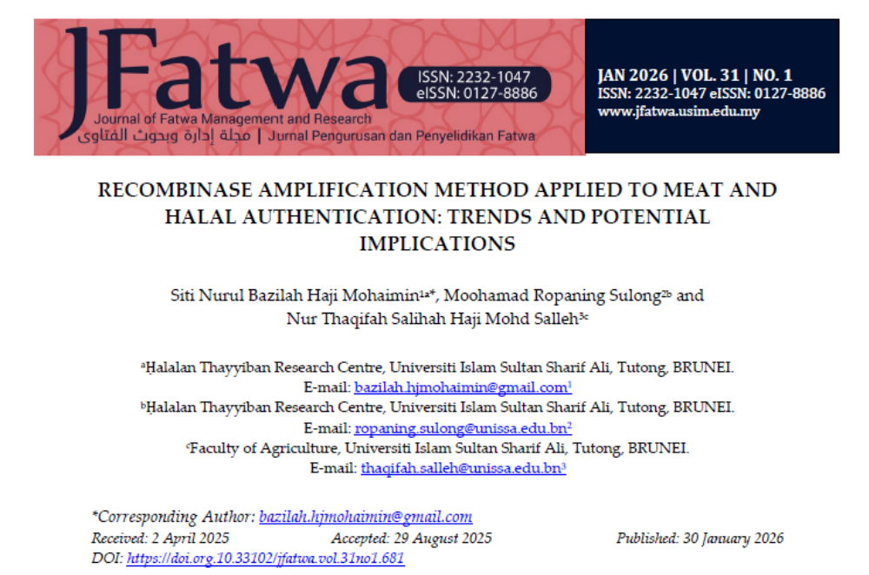
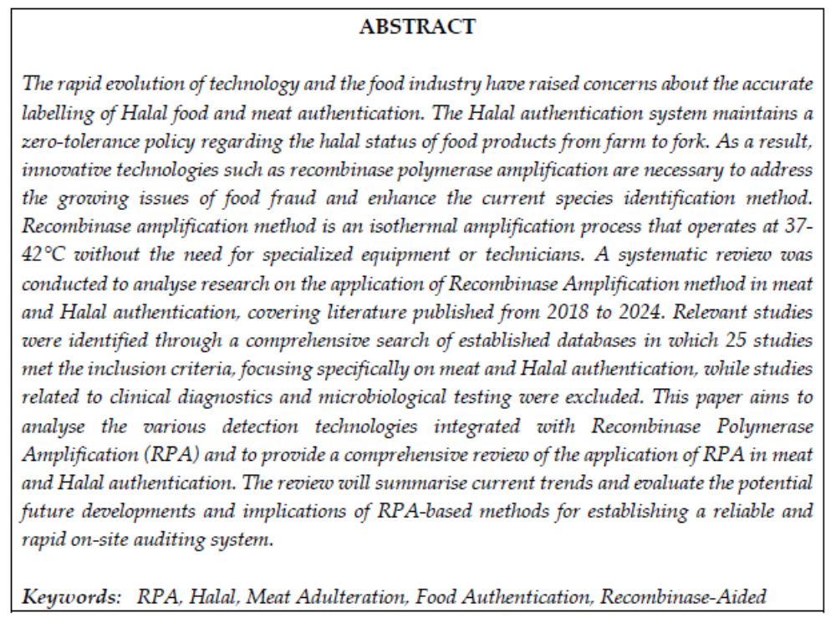
Case study - RPA in halal authentication
https://doi.org.10.33102/jfatwa.vol.31no1.681

Slide 15
Loop-Mediated Isothermal Amplification (LAMP)
  LAMP is another popular isothermal method.
  It runs at a slightly higher temperature than RPA, around 63°C, and uses a robust strand-displacing enzyme called Bst DNA polymerase.
  Unlike RPA's simple two-primer design, LAMP uses a complex network of 4 to 6 primers targeting 6 to 8 different regions on the DNA template.
  This multi-primer requirement makes LAMP highly specific; if even one primer fails to bind correctly, amplification will not occur.
  Furthermore, Bst polymerase is highly resistant to standard PCR inhibitors (like fats, salts, and sugars), making LAMP exceptionally reliable for testing raw or processed food products.

Slide 16
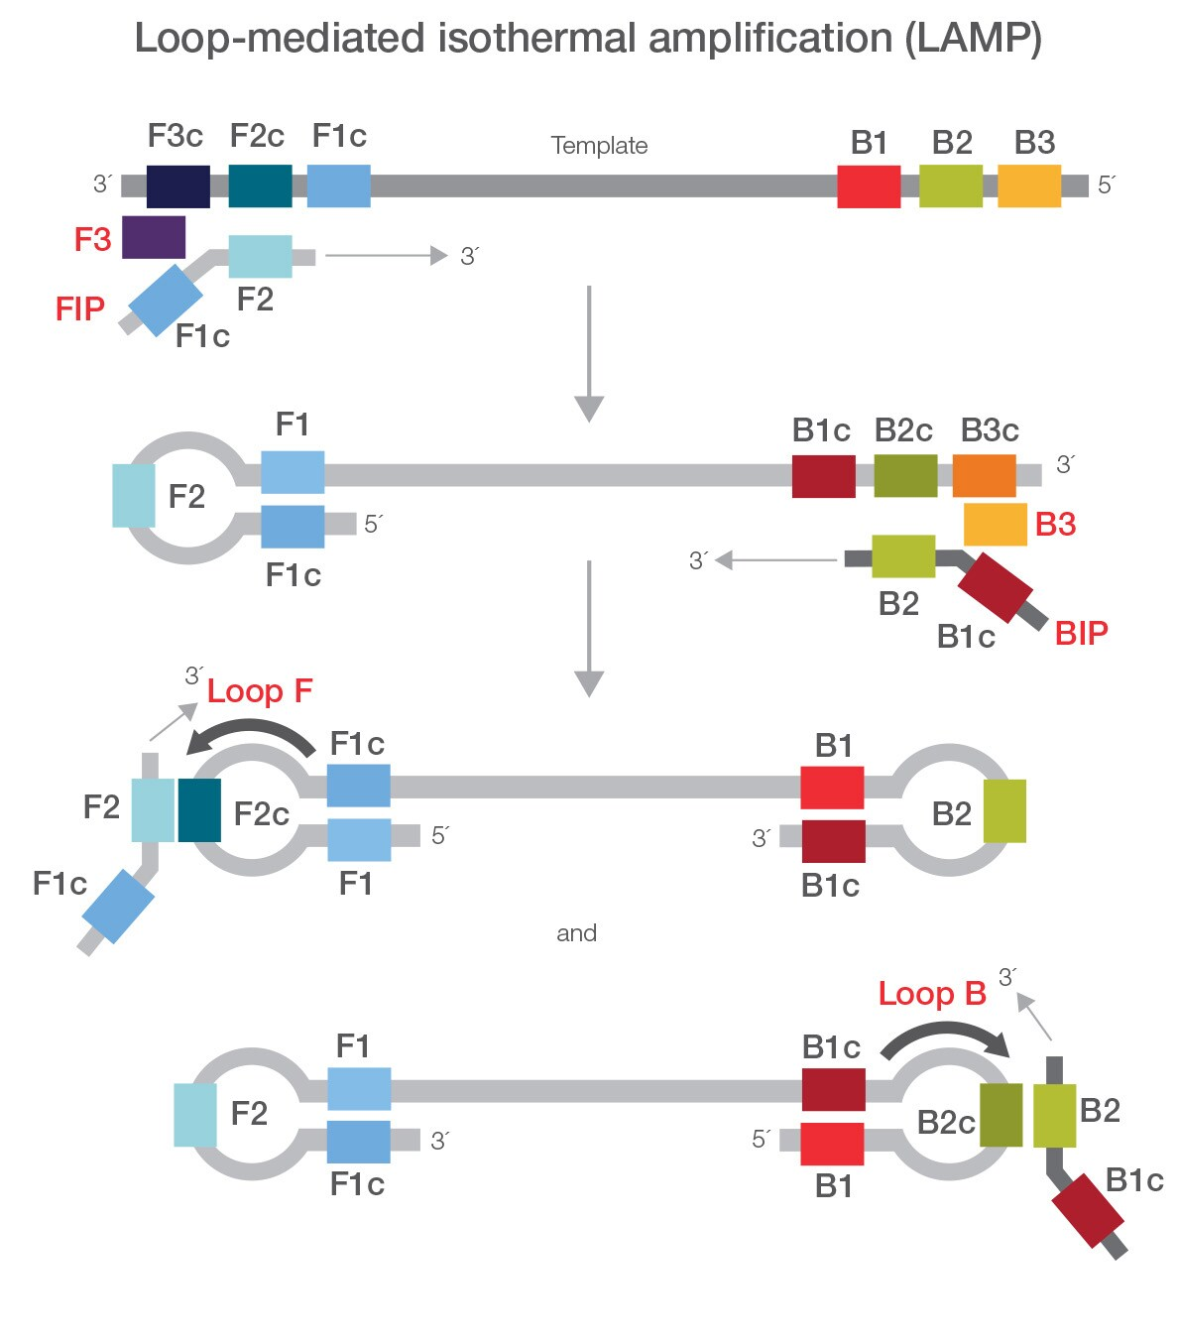
Schematic diagram on the mechanism of LAMP
https://www.thermofisher.com/my/en/home/life-science/pcr/isothermal-nucleic-acid-amplification/recombinase-polymerase-amplification.html
Thermo Fisher Scientific Inc.

Slide 17
How do we read a LAMP assay?
  The reaction produces a massive amount of DNA, yielding pyrophosphate ions as a byproduct.
  These ions bind to magnesium in the buffer to form magnesium pyrophosphate, a white precipitate that makes the solution cloudy.
  This turbidity can be tracked using portable photometers.
  Alternatively, we can add color-changing dyes. Dyes like Hydroxynaphthol Blue (HNB) react to the drop in free magnesium as the precipitate forms, shifting from violet to bright blue. This allows inspectors to verify the presence of porcine DNA visually without any instrumentation.
  When optimized, these visual assays can detect down to 0.03 femtograms of pork DNA, demonstrating sensitivity that matches or exceeds standard laboratory PCR.

Slide 18
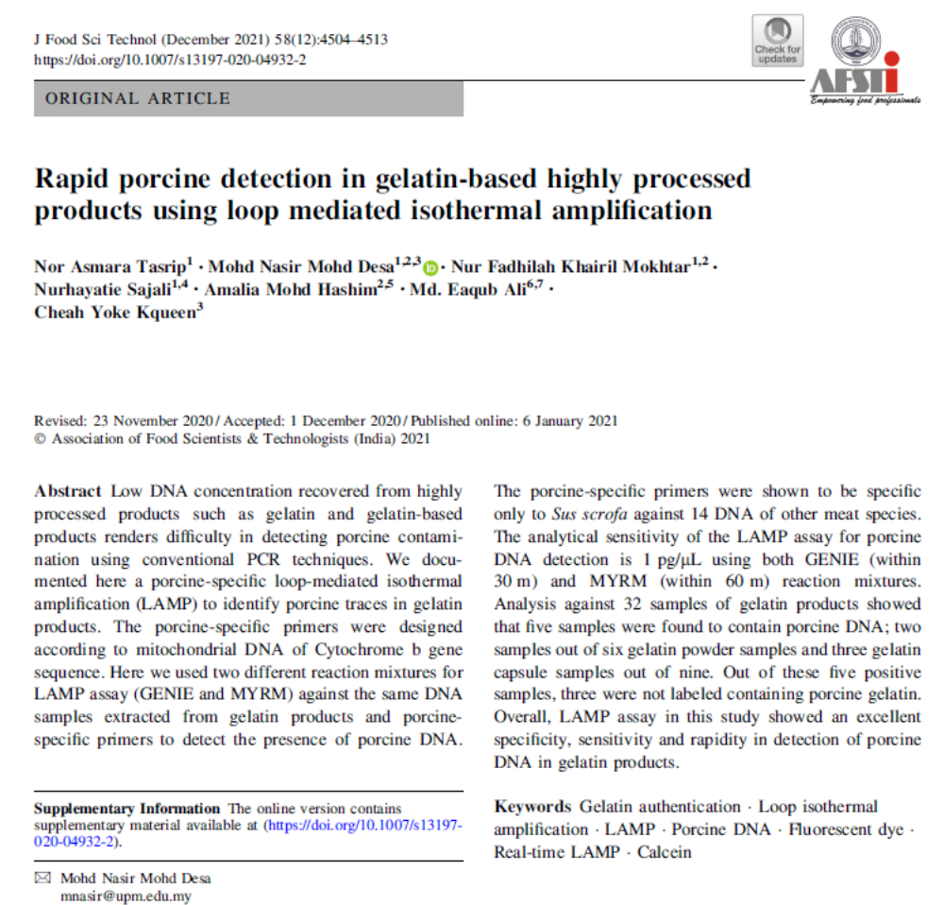
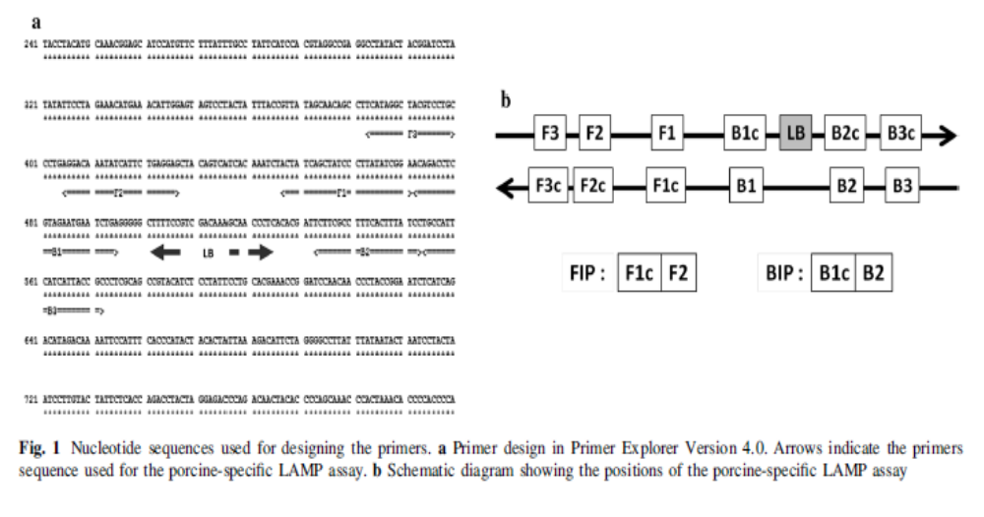
Case study - LAMP in halal authentication
https://link.springer.com/article/10.1007/s13197-020-04932-2

Slide 19
Clustered Regularly Interspaced Short Palindromic Repeats (CRISPR)
Here is how the mechanism works:
Designing the Target Guide The process begins with designing a guide RNA (gRNA) specifically tailored to recognize unique porcine gene sequences, such as cytochrome c oxidase subunit 1 (COX1), cytochrome b (Cytb), ND2, or CO1. These sequences are chosen because they are highly specific to pigs and do not cross-react with other animal DNA.
Forming the RNP Complex The designed gRNA is combined with a CRISPR-associated protein, most commonly Cas12 or Cas12a, to form a stable structure known as a Ribonucleoprotein (RNP) complex.
DNA Extraction and Amplification DNA is extracted from the food sample, often using a simple lysis buffer. To make the test more sensitive, this extracted DNA is frequently amplified using isothermal methods like Recombinase Polymerase Amplification (RPA) or Loop-Mediated Isothermal Amplification (LAMP) to increase the amount of target DNA before the CRISPR system is applied.
Target Recognition and Activation The RNP complex is introduced to the sample. The gRNA actively searches the sample for its matching porcine DNA sequence. When the gRNA successfully identifies and binds to this specific sequence, it triggers a conformational change in the Cas12 protein, effectively "activating" it.
Collateral Cleavage and Signal Generation Once activated, the Cas12 protein exhibits two types of cutting behavior:
  Cis-cleavage: It precisely cuts the targeted double-stranded porcine DNA.
  Trans-cleavage (Collateral Cleavage): Crucially, the activated Cas12 protein also indiscriminately cuts any nearby single-stranded DNA (ssDNA) in its vicinity.

Slide 20
How to read the CRISPR reaction?
To translate this collateral cutting into a readable result, testing kits (like the PORTECT kit) introduce a reporter compound into the mixture, such as an ssDNA probe conjugated with alkaline phosphatase (AP) or a fluorescent dye.
When Cas12 cuts this reporter compound, it generates a clear visual signal, such as a color change on a test strip or a fluorescent glow.
If porcine DNA is present, the Cas12 protein activates, cuts the reporter, and produces a color change.
If there is no porcine DNA, the Cas protein remains inactive, the reporter remains intact, and no signal is produced.

Slide 21
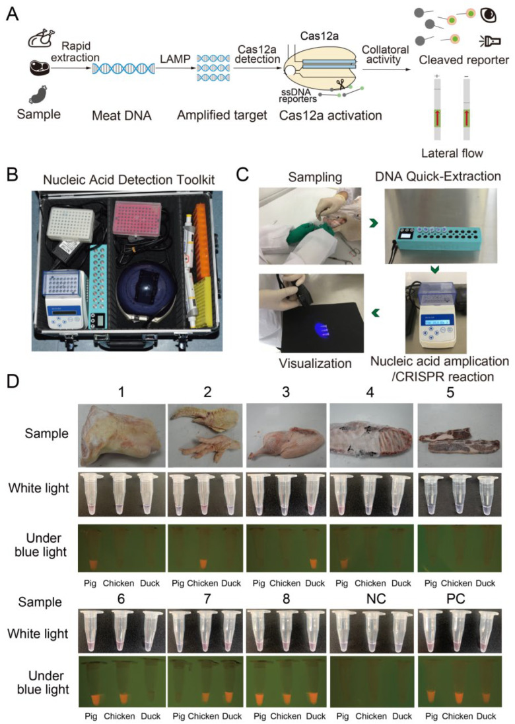
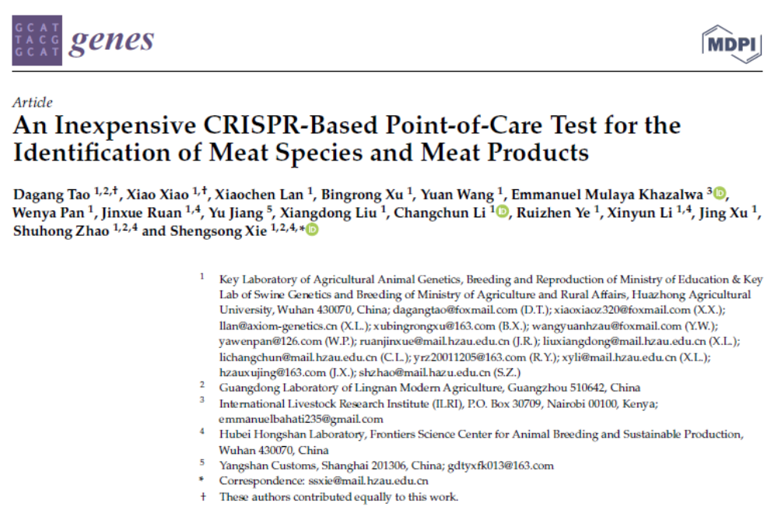
Case study -
mechanism and application of CRISPR
https://doi.org/10.3390/genes13050912

Slide 22
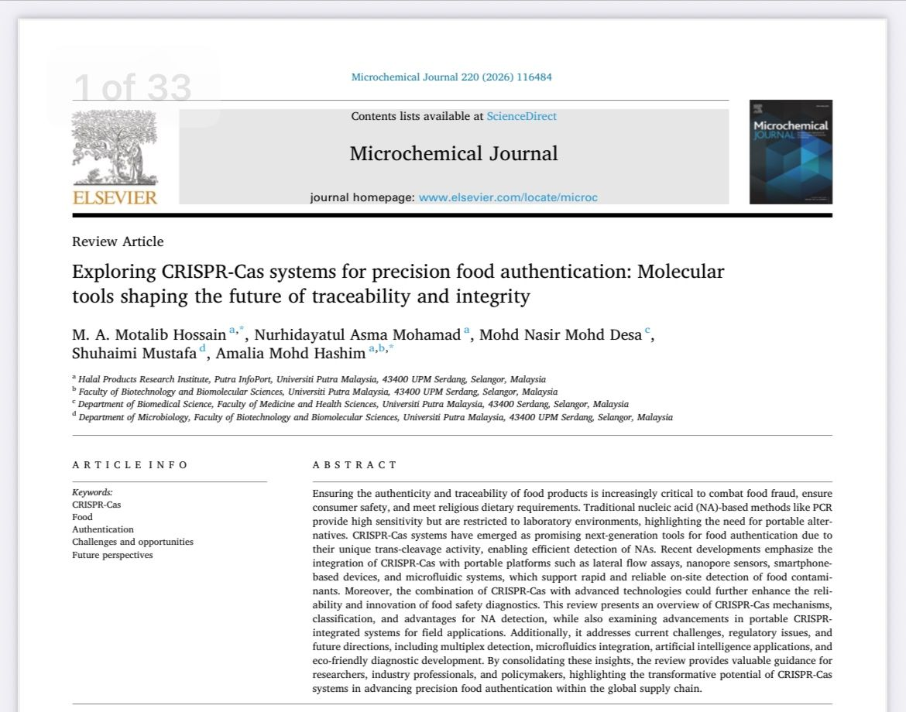
Additional reading on the potential of CRISPR
https://doi.org/10.1016/j.microc.2025.116484

Slide 23
Conclusion
  DNA remains the most reliable forensic target due to its stability under high-heat food processing.
  While centralized state laboratories maintain regulatory authority, point-of-need molecular diagnostics allow real-time audits across global supply chains.
  By deploying rapid isothermal assays like RPA, LAMP and CRISPR for initial screening, and reserving quantitative PCR for confirmation and untargeted audits, we can establish a robust, cost-effective safety net (dual-tiered architecture).
  This dual-tiered architecture ensures both the halal and toyyiban integrity of our global food supply.

